Slide 1
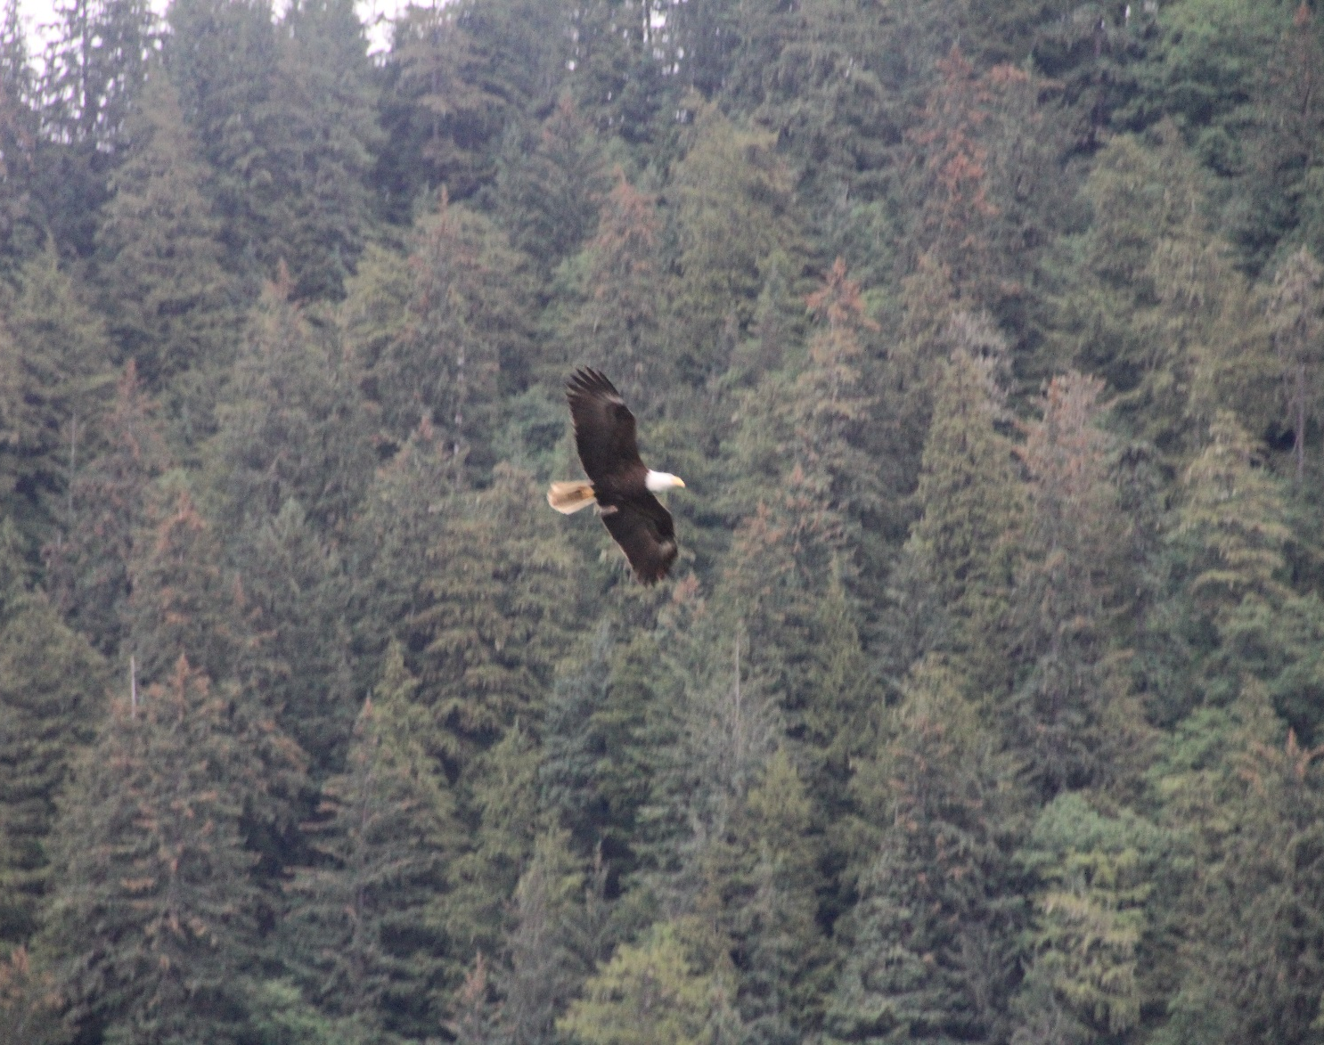
Wildlife
The Ketchikan Rainforest has an incredibly high concentration of bald eagles. Be prepared with your camera as you view these majestic creatures!

Slide 2
Canopy Tours
High octane zip line adventure
Safety equipped with harnesses, lanyards and dual-line cables
Seven lines along tree platforms
Significant walking, hiking, and climbing between lines

Slide 3
Off Road Adventure
Fully equipped mountain trail ATV tour
4 hours in length including lunch
Gear and safety briefing provided
Experienced guides
Ample opportunities to stop for pictures

Slide 4
Rainforest Adventure
Ketchikan

